Slide 1
CLAS 220 Introduction to Classical Mythology
Ovid: Metamorphoses 1-4

Slide 2
Quiz Question
Which woman pursued by Apollo becomes a laurel tree?
Io
Daphne
Callisto
Europa

Slide 3
Quiz Question
2. What is the name of the many-eyed creature Juno sends to guard Io?
Kraken
Hydra
Cerberus
Argos

Slide 4
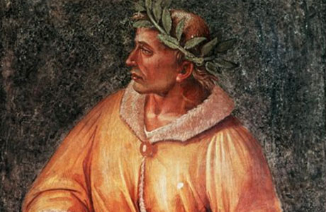
Ovid
43 BC-17 AD
From wealthy provincial family
Wrote didactic poetry about love (Amores, Ars Amatoria)
Exiled in 8 AD for “carmen et error” (“a poem and a mistake”)
Wrote poetry from exile in modern Romania

Slide 5
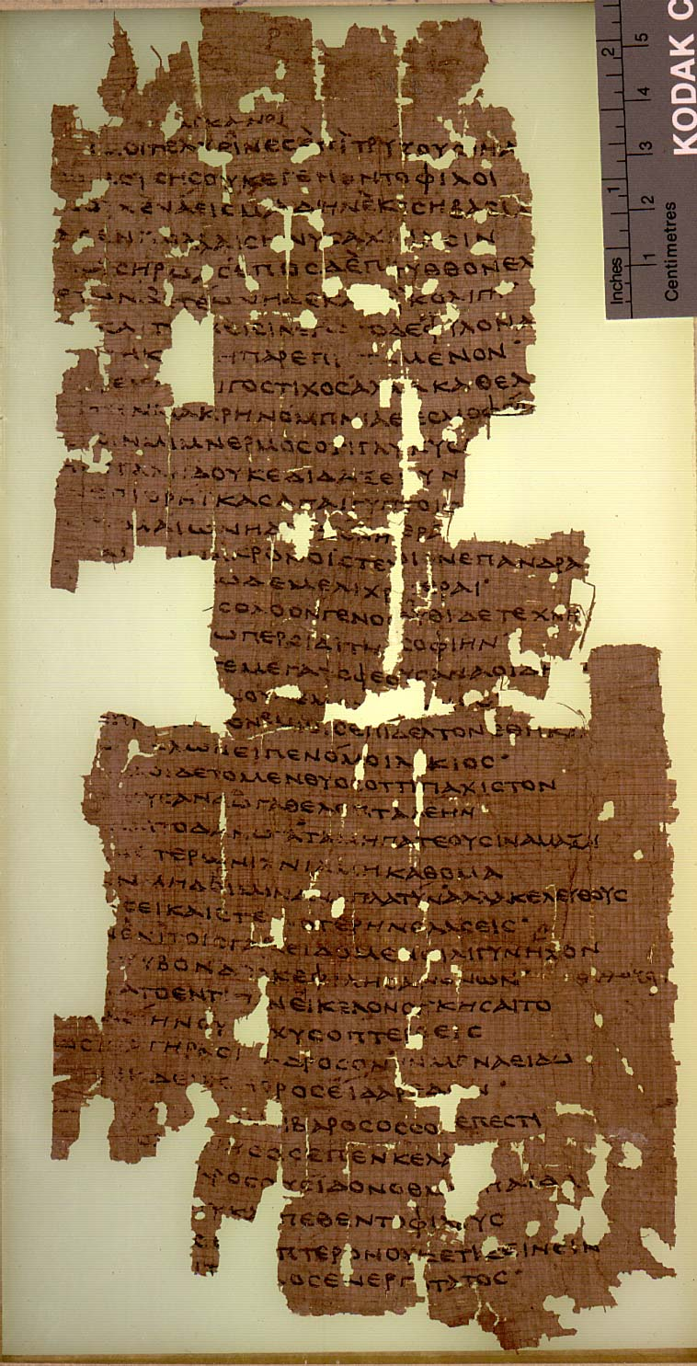
Ovid the Poet
Inspired by the poetry of Greece in the Hellenistic era (323-31 BC)
Example: the prologue to the Aitia of Callimachus:
“ignorant Telkhines, who are not dear to the Muses,
because I did not accomplish a continuous song
in many thousands of verses, either about kings or heroes…”
“For even when I, for the very first time, put writing-tablet
To my knees, Lycian Apollo spoke to me:
“….. Singer, fatten up your sacrificial victim,
but, my good man, keep your Muse slender.
And this, too, I command you: not to tread your wagons
Where people walk, and not to draw your chariot
On the common tracks, nor on broad roads, but on ways
Untrodden, even if your path is more narrow.” Which persuaded me.
For in that which we sing, we love the clarity
Of the cicada, and not the clamorous braying of donkeys.”
In other words, less is more.

Slide 6
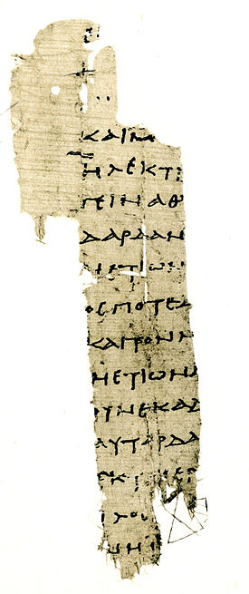
Hesiod’s Catalogue of women
Poem which continues on where the Theogony leaves off
Genealogy of all of the Greek heroes through the female line
Links all the local stories into one Panhellenic story
Ends with the courtship of Helen of Troy
Provides a model, and much of the content and even some of the structure, for Ovid’s Metamorphoses

Slide 7
The Metamorphoses
Epic poem in 15 books
Episodic, rather than continuous narrative
A series of myths about transformations
Complex narrative structure
Covers the whole of history from the creation of the world to the deification of Julius Caesar, including the action of the Iliad, Odyssey and Aeneid
Cf. Callimachus’ Aetia, a poem which collects stories of the origins of things
a preference for the more obscure or unusual versions of stories:
“This last she liked the best, because the tale was far from widely known” (IV. 51-2; one of the daughters of Minyas)

Slide 8
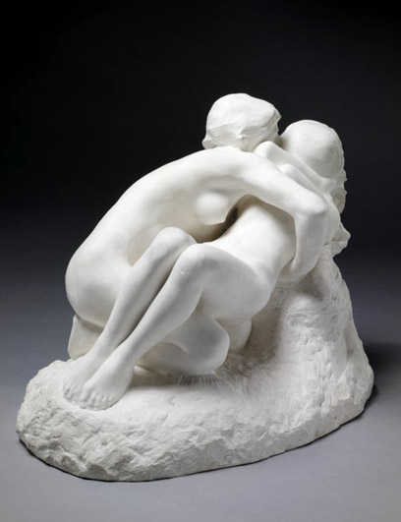
The Big Structure of the Poem
The Creation
The Loves of the Gods
Theban Cycle
Perseus Cycle
Contests between Gods and Men
Athenian Cycle
Orpheus Cycle
Trojan Cycle
Aeneas Cycle
Roman Cycle
But also lots of digressions,
Stories within stories

Slide 9
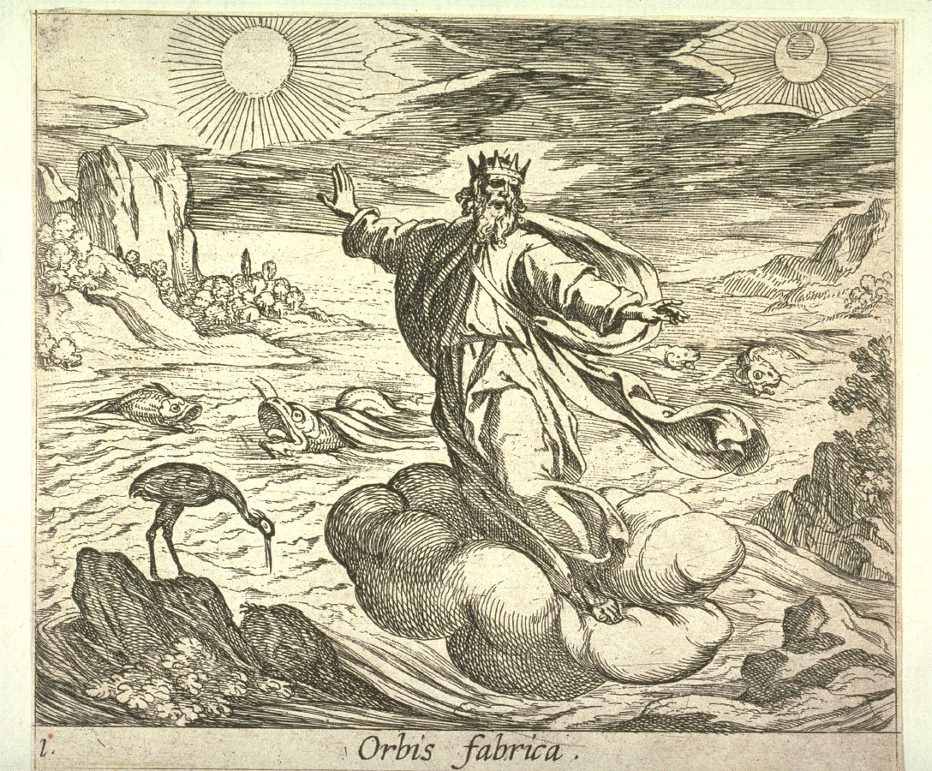
1. The Creation

Slide 10
1. The Proem
In nova fert animus mutatas dicere formas corpora; di, coeptis (nam vos mutastis et illas) adspirate meis primaque ab origine mundi ad mea perpetuum deducite tempora carmen!
Of bodies changed to other forms I tell;
You Gods, who have yourselves wrought every change,
Inspire my enterprise, and lead my lay
In one continuous song from nature’s first
Remote beginnings to modern times.

Slide 11
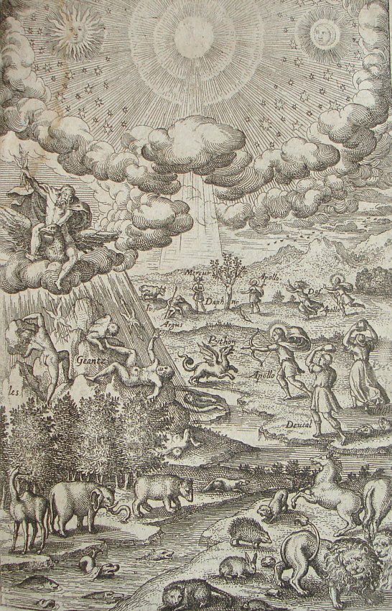
1. The Creation
“Ere land and sea and the all-covering sky
Were made, in the whole world the countenance
Of nature was the same, all one, well named
Chaos, a raw and undivided mass,
naught but a lifeless bulk, with warring seeds
Of ill-joined elements compressed together.”
Cf. Hesiod, Theogony.

Slide 12
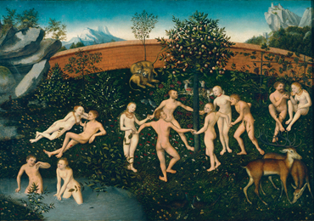
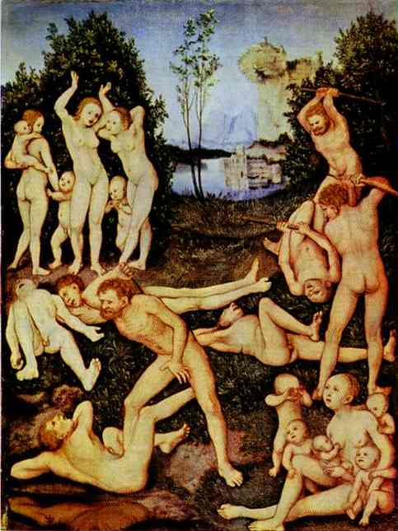
1. Ages of Mankind
Also from Hesiod, Works and Days, who adds a stage of heroes between bronze and iron
Golden Age: no war or agriculture
Silver Age: Saturn falls; age of Jove; seasons, agriculture
Bronze Age: war with honour
Iron Age: “our” own time; fallen and corrupt

Slide 13
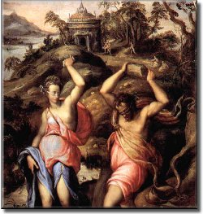
1. The Flood, Deucalion and Pyrrha
Jupiter wants to punish humans after visiting Lycaon, who tries to kill Jupiter after trying to feed him the flesh of a human hostage
Lycaon transformed into wolf
Flood destroys all of humanity except for the pious Deucalion and Pyrrha
How to repopulate the earth? Throw your mother’s bones behind you.
Then animals re-created, including Python

Slide 14
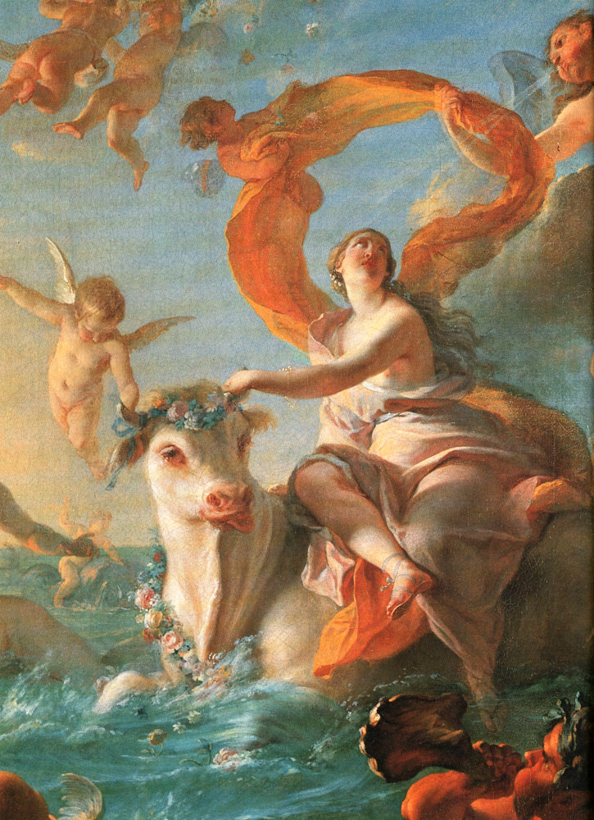
2. The Loves of the Gods

Slide 15
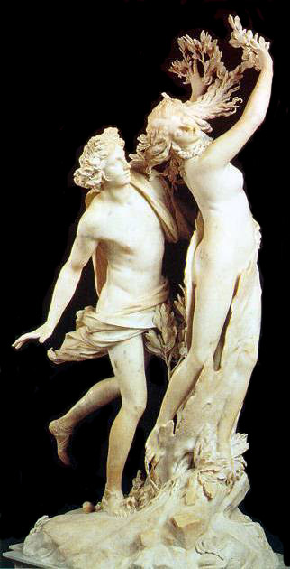
2. Apollo and Daphne
Segue: Apollo kills Python
Apollo then brags that he can defeat anyone, including Cupid
Cupid makes him fall in love with Daphne, whom he makes flee Apollo
Apollo chases Daphne, who prays to her father (river-god) for rescue
Daphne turned into laurel tree, which Apollo continues to grope
“Scarce had she made her prayer when through her limbs
A dragging langour spread, her tender bosom
Was wrapped in thin smooth bark, her slender arms
Were changed to branches and her hair to leaves;
Her feet but now so swift were anchored fast
In numb stiff roots, her face and head became
The crown of a great tree; all that remained
Of Daphne was her shining loveliness”

Slide 16
transition
Note: Both Daphne and Io have rivers for fathers

Slide 17
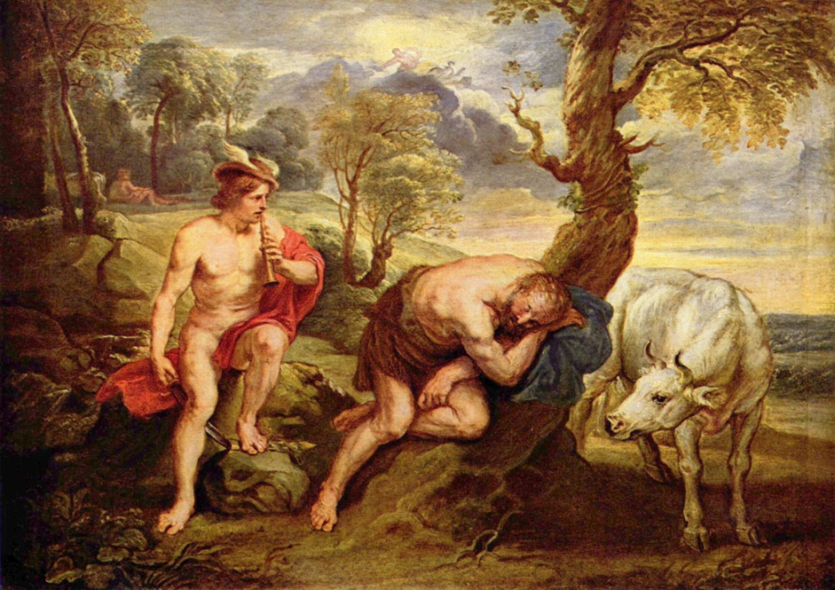
2. Io
Jupiter falls in love with Io, wants to have sex with her
Covers forest in cloud to hide from Juno, who gets suspicious
Jupiter turns Io into white heifer, which Juno finds beautiful and takes
Many-eyed Argos sent to guard the heifer-Io
Jupiter sends Mercury to lull Argos to sleep, then kill him
Juno uses his eyes for her bird, the peacock
Juno torments Io with gadfly; Jupiter eventually able to return her to human form
Becomes goddess, son Epaphus

Slide 18
transition
Epaphus brags that his mother is a goddess; his friend Phaethon is jealous…

Slide 19
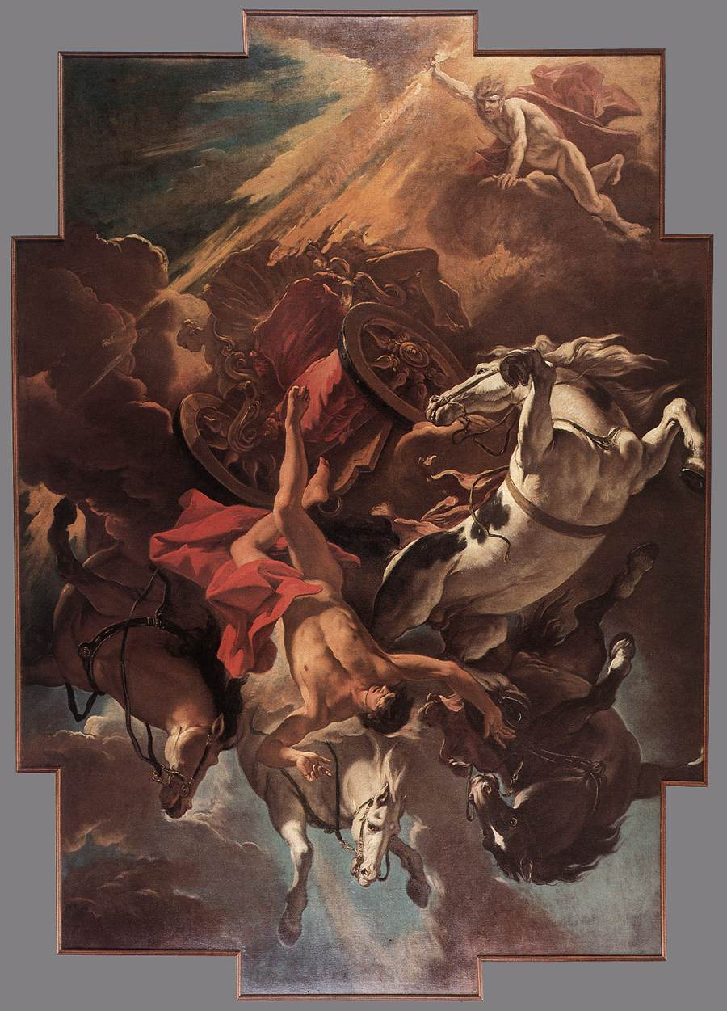
2. Phaethon
Segue to Phaethon, who’s jealous of Epaphus for getting recognition that his mother’s a goddess
Phaethon is son of Sun, but not acknowledged
Asks favor from Sun to prove he’s Sun’s son; asks to drive Sun’s chariot
Disaster

Slide 20
transition
Jove travels the Earth to make sure everything’s OK; in Arcadia he meets Callisto…

Slide 21
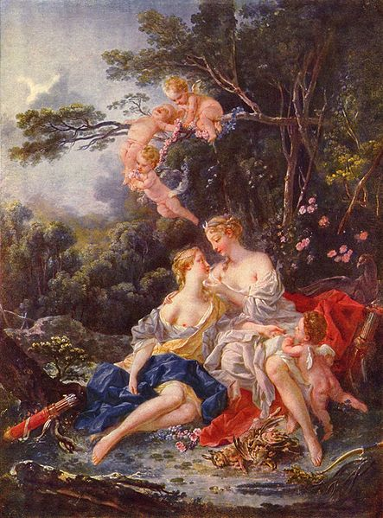
2. Callisto
Another nymph that Jove falls in love with.
He disguises himself as Diana and woos her that way
When she becomes pregnant, Diana expels her from her group; Juno turns her into bear
Later, Callisto, still a bear, meets her son, who tries to kill her
Jupiter turns both of them into constellations (Great and Little Bear)
Juno furious

Slide 22
transitions
Crow once beautiful princess, punished because she reveals the birth of Erichthonius (founder-king of Athens)
Hephaestus tried to rape Athena, ejaculated on her thigh; she tosses his semen on the ground, and it becomes Erichthonius, whom she hides in a box
Crow tells this story (cleaned up!) to raven, who is still white, to encourage raven to keep quiet about the infidelity of Apollo’s beloved Coronis
Raven tells Apollo anyway, and he kills Coronis and turns raven black

Slide 23
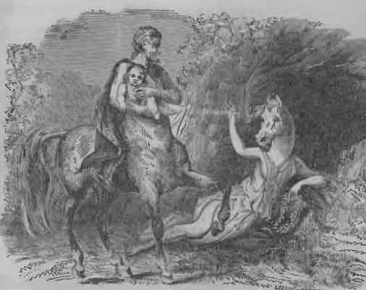
2. Ocyrhoe
Apollo rescues Coronis’ son (healing god Asclepius) from her womb, and sends him to be raised by the centaur Chiron
Chiron’s daughter Ocyrhoe prophesies that Asclepius will become great god, also prophesies father’s death
Punished by being turned into horse

Slide 24
transitions
Chiron grieves
Begs Apollo for help
But Apollo is in Thessaly,
falling in love with Prince Admetus

Slide 25
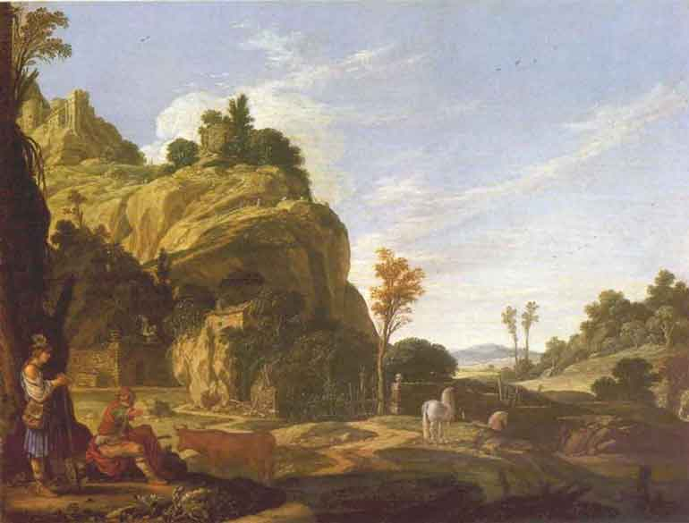
2. Mercury and Battus
Variant of the story in the Homeric Hymn to Hermes, where Hermes steals Apollo’s cattle as baby
Here, Apollo is playing the lovestruck shepherd, and doesn’t notice his flocks are missing
Mercury steals the cattle, bribes herdsman Battus not to tell
Battus says he’ll be as silent as a stone
Minutes later, Mercury returns in disguise, and sucessfully bribes Battus into revealing where the cattle are
Mercury turns Battus into stone

Slide 26
transitions
Mercury leaves for Athens…

Slide 27
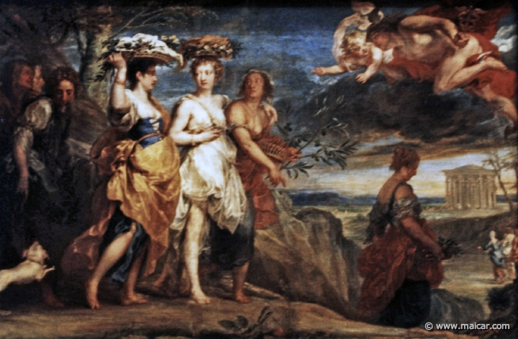
2. Aglauros
Meanwhile, Mercury falls in love with another Athenian princess, Herse, at festival of Minerva
Gets her sister Aglauros to help him, she demands money
Minerva angry, sends Fury to make Aglauros jealous
Jealousy turns Aglauros to stone

Slide 28
transitions
Mercury returns to the heavens,
Where Jove asks for a favor…

Slide 29
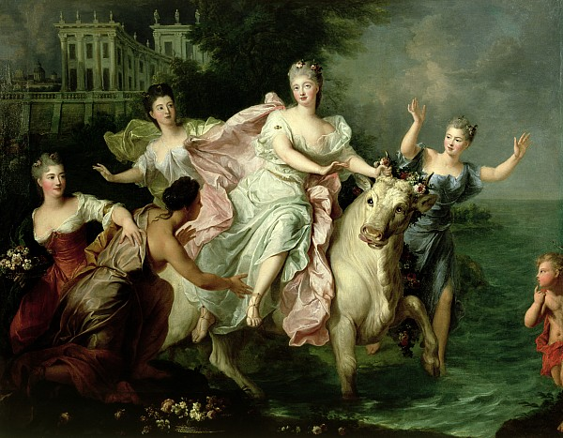
2. Jupiter and Europa
Jupiter falls in love with Europa, disguises himself as beautiful bull to get close to her.
Carries her away from Tyre (modern Lebanon) to Crete on his back
Seduces her there

Slide 30
transitions
Europa’s father sends her brother Cadmus to look for her…

Slide 31
Quiz Question
3. What is the name of the woman who loves Narcissus?
Salmacis
Myrrha
Leucothoe
Echo

Slide 32
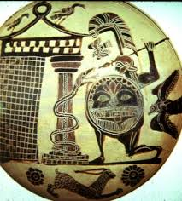
3. Theban Cycle

Slide 33
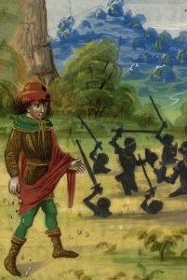
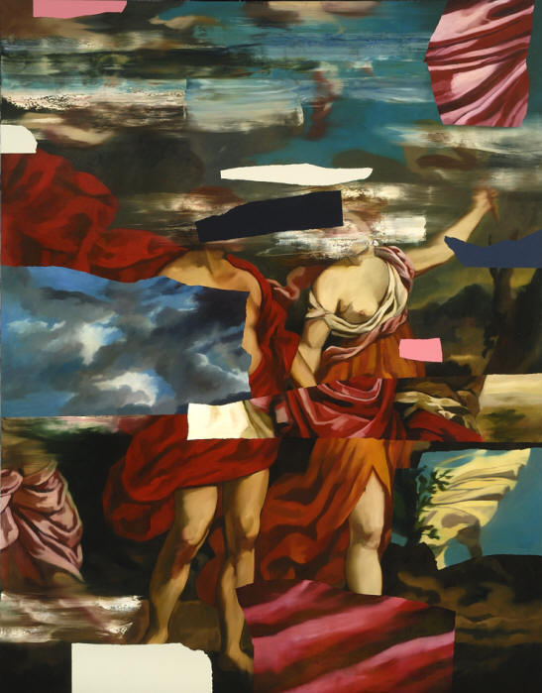
3. Cadmus
Sent by Europa’s father to look for her
Ends up founding Thebes:
Slays serpent
On Minerva’s instructions, plants serpent’s teeth in soil
A race of warriors (“Spartoi”) are born
Most of them immediately die in battle
Five survive to rule Thebes
Cadmus marries Harmonia, daughter of Mars and Venus

Slide 34
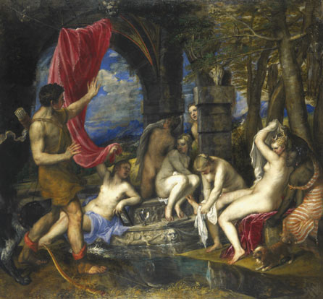
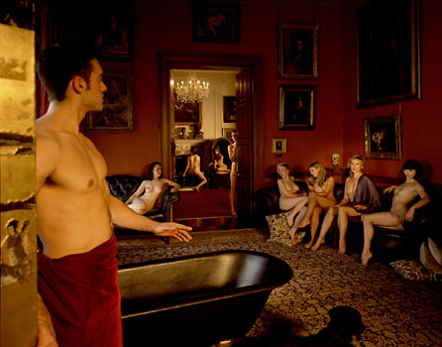
3.Diana and Actaeon
All seems to be going well for Cadmus
One day, his grandson Actaeon is out hunting
Runs across Diana and her nymphs bathing
Furious, Diana turns Actaeon into stag
Actaeon torn to pieces by his own hunting dogs
Is this just? Ovid asks

Slide 35
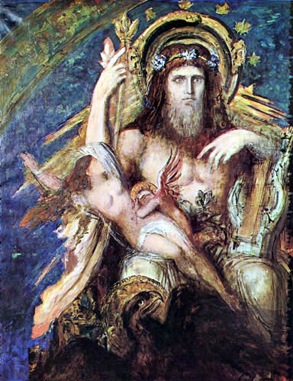
3. Semele and Bacchus
Cf. the Bacchae
Yet another mortal woman Jupiter falls in love with
This time, Juno makes the girl wonder if the man she’s sleeping with is really Jupiter
Juno persuades Semele to get Jupiter to have sex with her as himself
This fries Semele to a crisp
The infant Dionysus is brought to term on Jupiter’s thigh

Slide 36
transitions
While Bacchus is being raised on earth, Jupiter and Juno get talking…

Slide 37
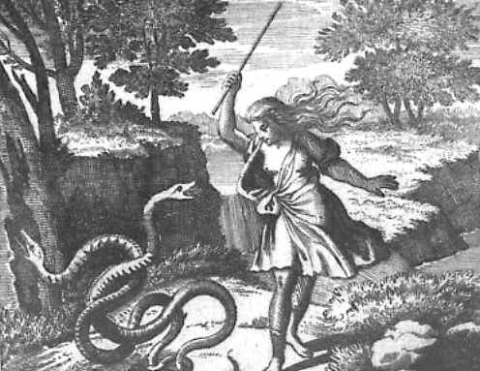
3. Tiresias
Jupiter and Juno debate whether men or women enjoy sex more
They decide to ask Tiresias, who should know because he’s lived as both genders after twice watching snakes copulate and hitting them with stick
He says women get most of the pleasure
Juno blinds him
Jupiter makes him a prophet

Slide 38
transitions
The first to consult Teiresias is the nymph Liriope. She has a son, Narcissus…

Slide 39
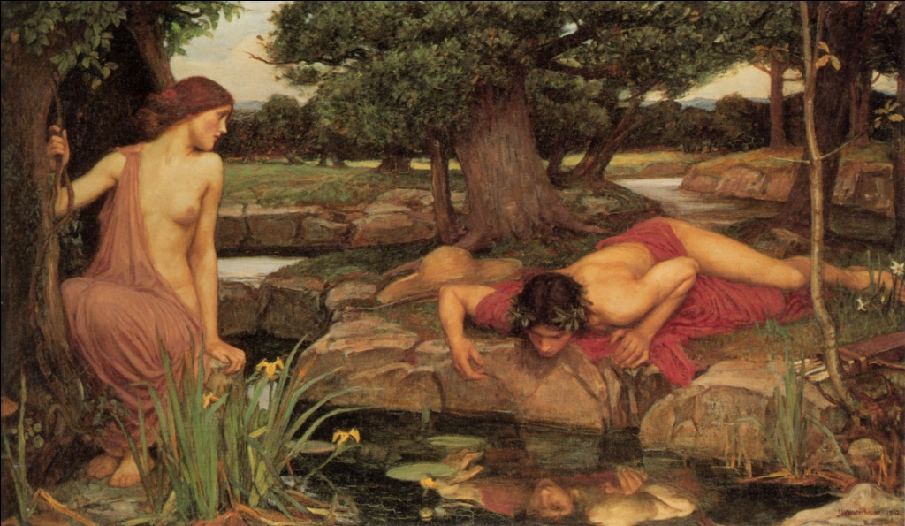
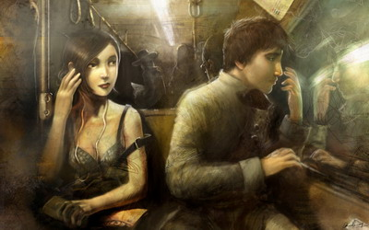
3. Narcissus and Echo
Segue: Narcissus’ mother asks Tiresias to prophecy her son’s fate, he replies that he’ll have a long life if he doesn’t know himself
Narcissus grows up to be beautiful, desired by men and women everywhere
Finally one boy curses Narcissus to fall in love with self
Stares at reflection in pool till he wastes away, becomes narcissus flower
Meanwhile, the nymph Echo is raped by Jupiter
Juno punishes her by only being able to repeat what other people say
She falls in love with Narcissus, and wastes away to an echo while he wastes away as well
“He bolted, shouting “Keep your arms from me! Be off! I’ll die before I yield to you.” And all she answered was “I yield to you.”

Slide 40
transitions
The only one who doesn’t praise Teiresias’ ability as a prophet is Pentheus…

Slide 41
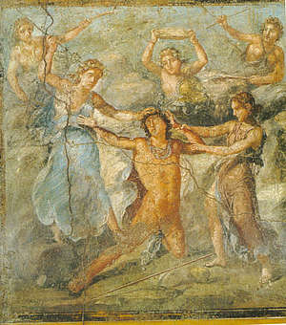
3. Pentheus and Bacchus
Cf. the Bacchae, again
Instead of holding Bacchus himself prisoner, in this version Pentheus captures a former sailor, who tells story of Bacchus overwhelming a ship of men who try to kidnap him; they’re turned into dolphins (cf. Homeric Hymn to Dionysus)
Pentheus’ prisoner escapes; Pentheus ripped to shreds by mother and aunts

Slide 42
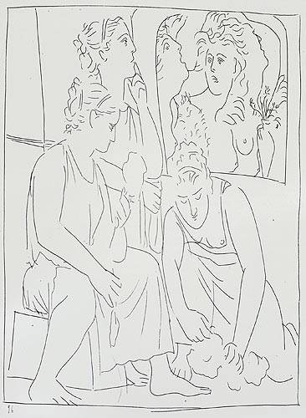
3. The Daughters of Minyas
The only women in Thebes who still refuse to worship Dionysus
They keep weaving (activity associated with Minerva) and, as they weave, they tell stories (obscure stories in particular):
Pyramus and Thisbe
The Sun in love with Leucothoe
Salmacis and Hermaphroditus
They’re thus doing what should be good womanly things, but because they ignore Dionysus they’re turned into bats

Slide 43
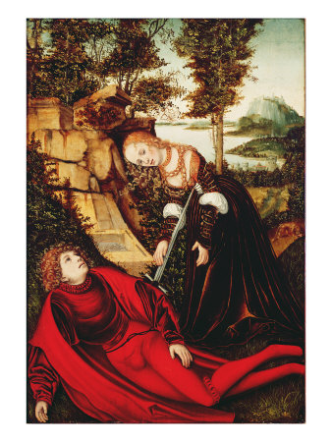
3. Pyramus and Thisbe
Familiar story to us, thanks to Shakespeare
Pyramus and Thisbe are beautiful young couple in Babylon (now Baghdad), who fall in love, but their parents don’t approve
They decide to flee and to meet at Ninus’ tomb in Nineveh
When Thisbe gets there, a lioness charges her and gets her shawl; she escapes, but the bloody shawl is left behind
Pyramus finds it, is convinced Thisbe is dead, stabs himself
Thisbe returns, sees Pyramus die, stabs herself
Mulberry tree’s berries stained red

Slide 44
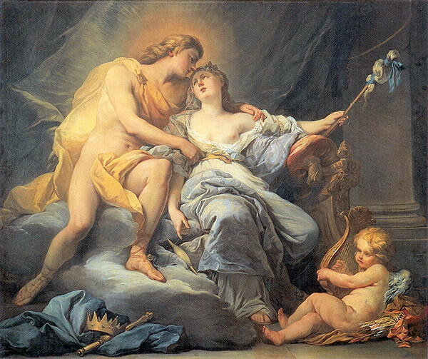
3. The Sun in Love with Leucothoe
Story begins with retelling of Vulcan’s trap for Venus and Mars’ adultery as told in the Odyssey
It turns out that the Sun was the one who first caught Venus and Mars in the act
In punishment, Venus makes the Sun fall in love with Leucothoe
Clytie, Leucothoe’s rival, is jealous and makes sure that Leucothea’s father finds out about her dalliance; he buries her alive
She becomes the frankincense tree

Slide 45
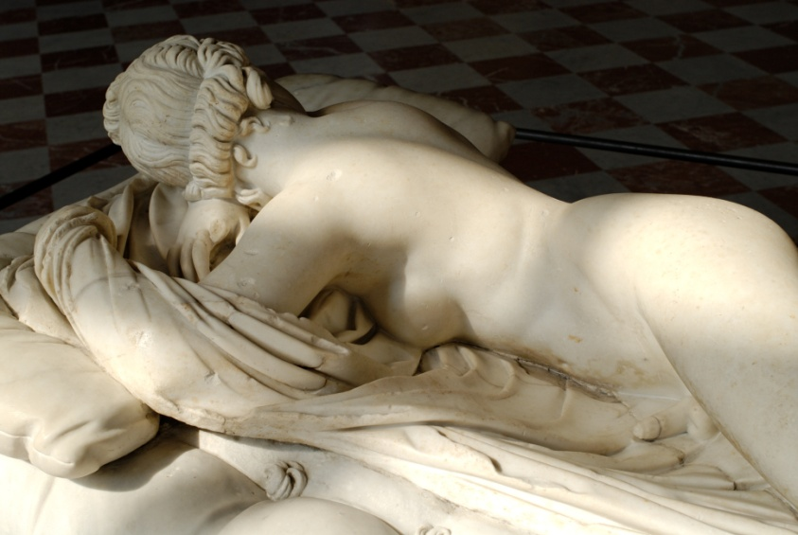
3. Salmacis and Hermaphroditus
Hermaphroditus is another beautiful boy, son of Hermes and Aphrodite
Salmacis, a nymph, falls in love with him
She surprises him while bathing in a pond
They wrestle and he tries to escape her advances
She prays that they be joined in one…
… and they are, both sexes in one body
From then on, that pool changes the gender of those who step in it

Slide 46
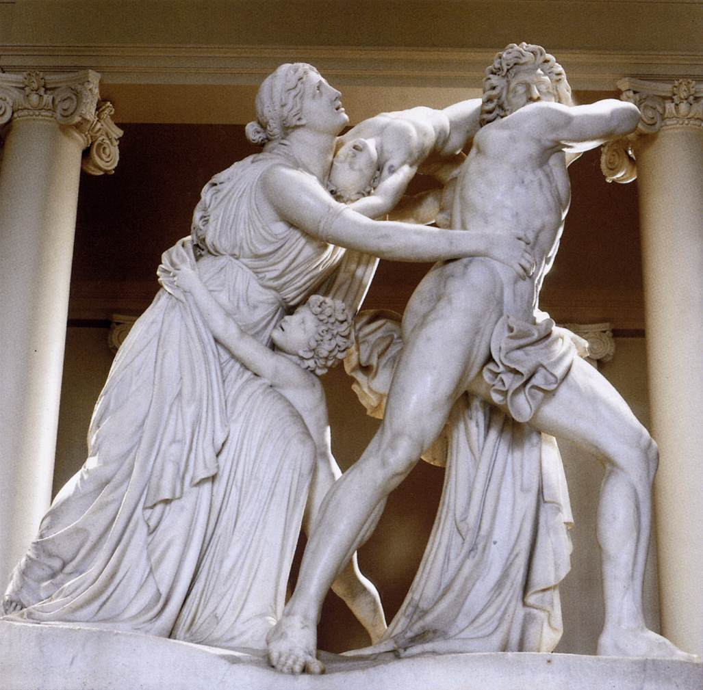
3. Athamas and Ino
Interlude; the daughters of Minyas punished for not recognizing Bacchus by transforming into bats
Juno still jealous that Bacchus is now recognized as a god
She makes Ino’s husband Athamas crazy; he thinks she and kids are lioness and cubs and bashes his own child against rocks
She escapes into sea with other child; the two of them become sea-gods
NB she’s the sea-goddess Leucothea, who rescues Odysseus

Slide 47
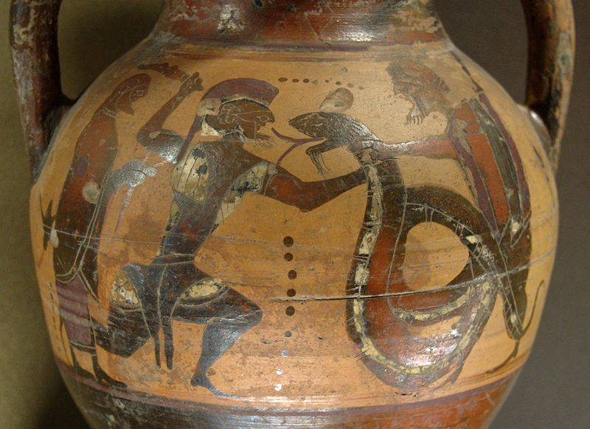
3. The Transformation of Cadmus
Cadmus, despondent at everything that’s happened to his family, prays to be transformed into a snake
He is
So is his wife Harmonia

Slide 48
Quiz Question
4. What’s the name of Andromeda’s mother? a. Io
b. Harmonia
c. Cassiopeia
d. Medusa

Slide 49
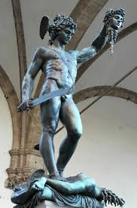
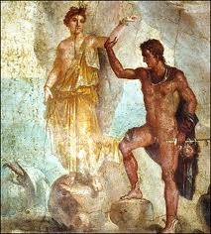
4. Perseus Cycle

Slide 50
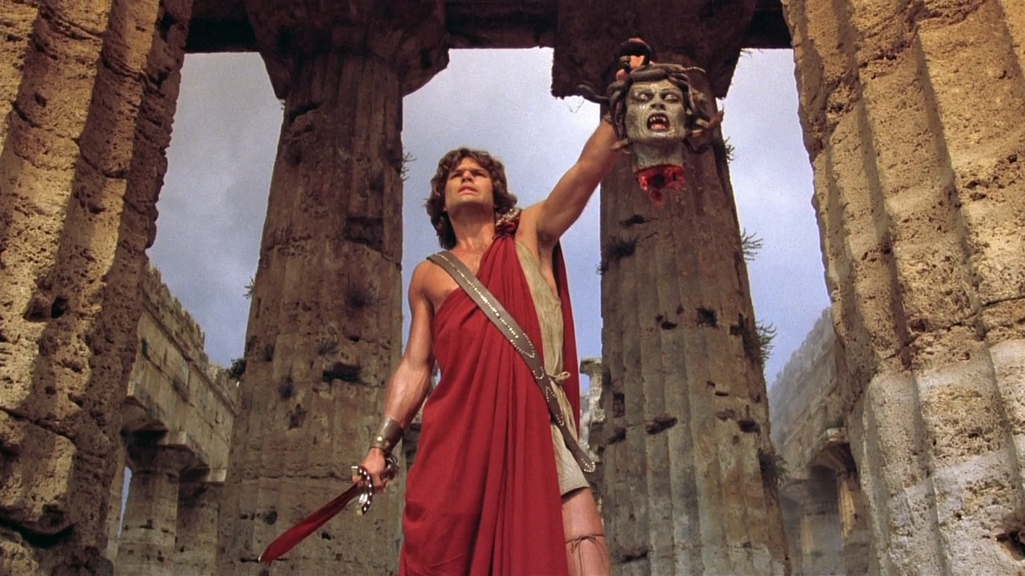
The Clash of the Titans

Slide 51
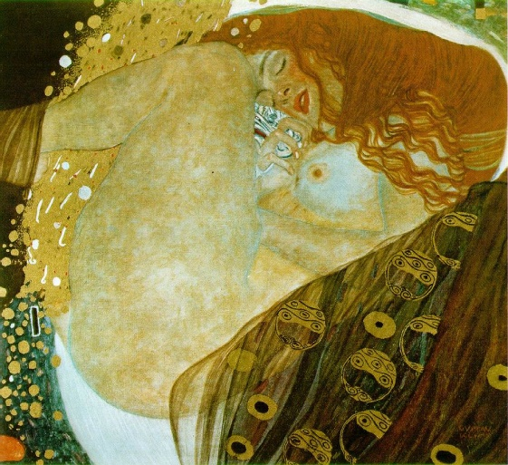
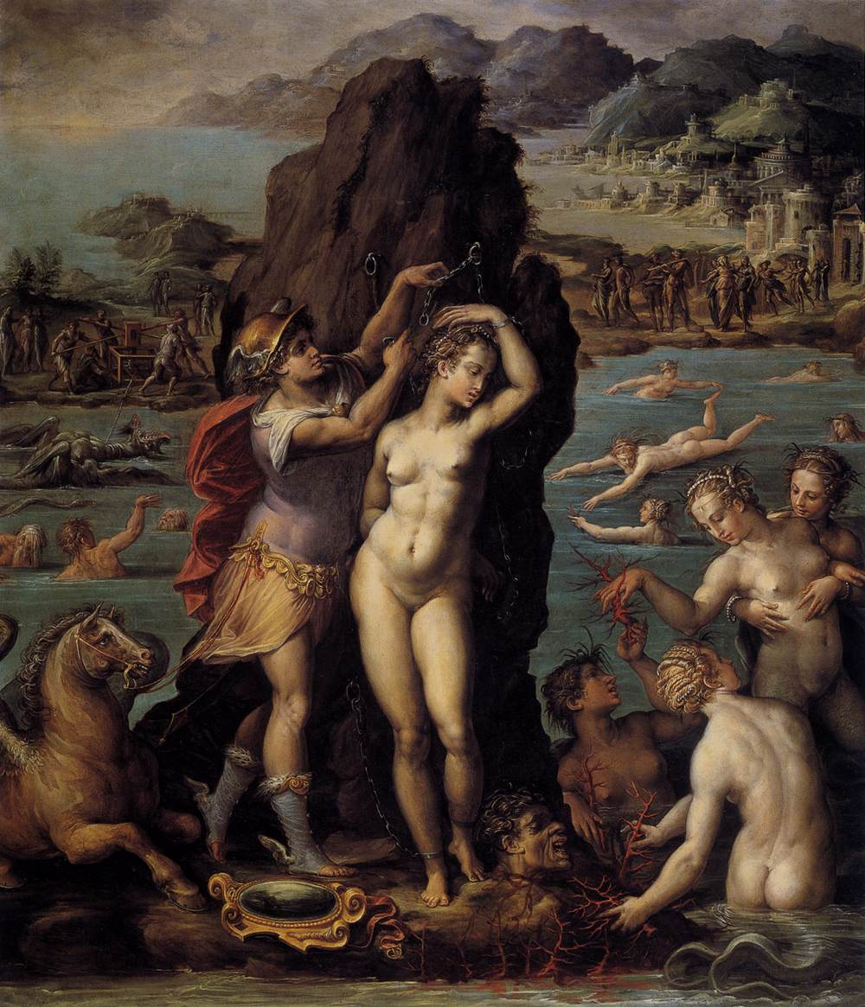
4. Perseus and Andromeda
Now only Acrisius of Argos denies Bacchus
He also denies that his daughter Danae has slept with Jupiter, and that her son Perseus is Jupiter’s son
Flash-forward to Perseus’ adventures: killing Medusa, turning Atlas into mountain
Then flies to Ethiopia, where princess Andromeda is chained to rock to be eaten by sea-beast because mother Cassiopea compared her beauty to that of the Nereids, who call down a flood that can only be appeased with sacrifice of Andromeda
Perseus gets to marry Andromeda in exchange for killing beast
At wedding banquet, tells story of how coral was invented when he wrapped Medusa’s head in seaweed

Slide 52
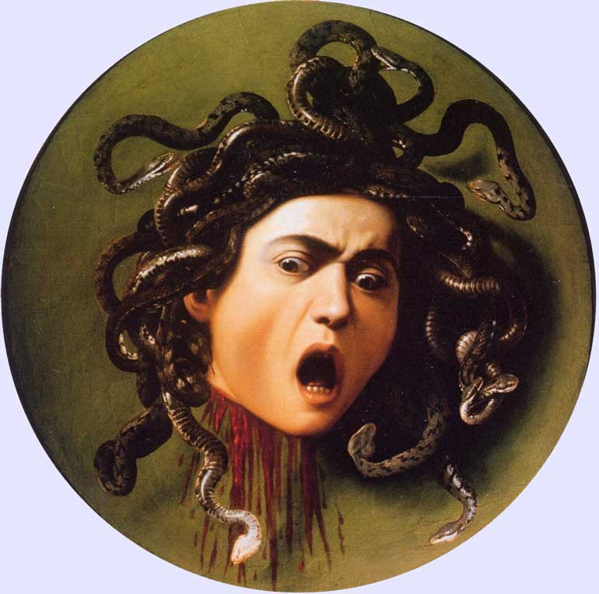
4. Medusa
Also tells story of how Medusa gets her snaky, deadly hair
Beautiful maiden with beautiful hair
Raped by Neptune in temple of Athena
Athena outraged at the sacrilege, and punishes Medusa with her snaky locks

Slide 53
Quiz Question
5. What happens to Pyramus and Thisbe?
They live happily ever after.
He becomes suspicious of her, and leaves.
She marries his best friend.
They each stab themselves, thinking the other is dead.

